Slide 1
Software Project Management

Slide 2
Software project management
Concerned with activities involved in ensuring that software is delivered on time and on schedule and in accordance with the requirements of the organisations developing and procuring the software.
Project management is needed because software development is always subject to budget and schedule constraints that are set by the organisation developing the software.

Slide 3
Management activities
Proposal writing.
Project planning and scheduling.
Project costing.
Project monitoring and reviews.
Personnel selection and evaluation.
Report writing and presentations.

Slide 4
Project planning
Probably the most time-consuming project management activity.
Continuous activity from initial concept through to system delivery. Plans must be regularly revised as new information becomes available.
Various different types of plan may be developed to support the main software project plan that is concerned with schedule and budget.

Slide 5
Activity organization
Activities in a project should be organised to produce tangible outputs for management to judge progress.
Milestones are the end-point of a process activity.
Deliverables are project results delivered to customers.
The waterfall process allows for the straightforward definition of progress milestones.

Slide 6
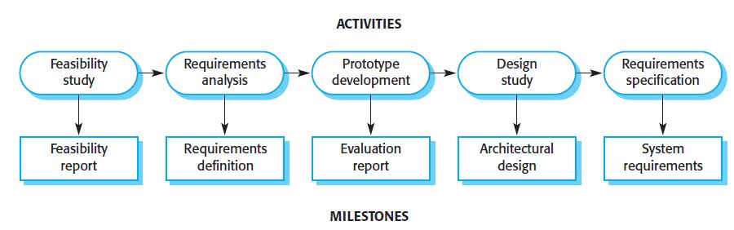
Milestones
in the requirement process

Slide 7
Project scheduling
Split project into tasks and estimate time and resources required to complete each task.
Organize tasks concurrently to make optimal use of workforce.
Minimize task dependencies to avoid delays caused by one task waiting for another to complete.
Dependent on project managers intuition and experience.

Slide 8
Activity networks
Graphical notations used to illustrate the project schedule.
Show project breakdown into tasks. Tasks should not be too small. They should take about a week or two.
Activity charts show task dependencies and the critical path.

Slide 9
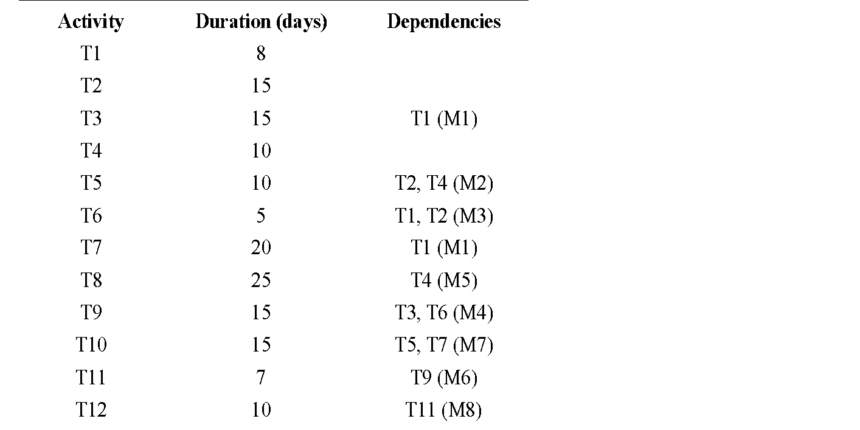
Task durations and dependencies

Slide 10
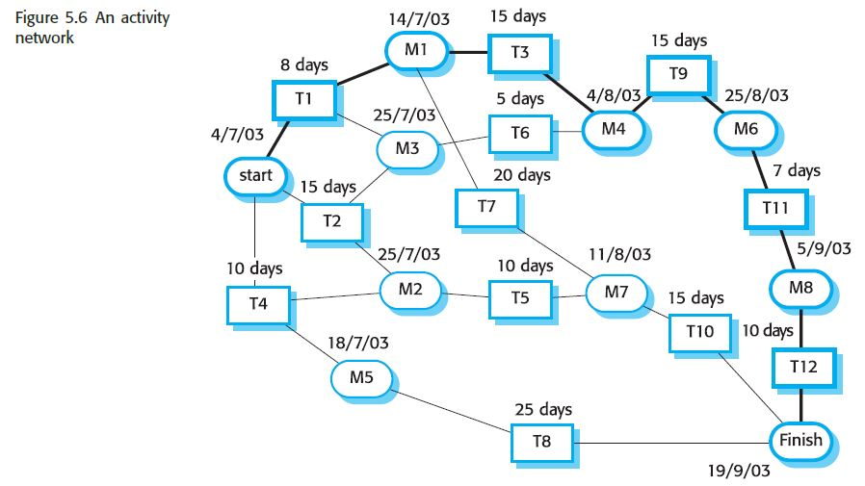
An activity network

Slide 11
Activity network
Given the dependencies and estimated duration of activities, an activity chart that shows activity sequences may be generated.
This shows which activities can be carried out in parallel and which must be executed in sequence because of a dependency on an earlier activity.
Activities are represented as rectangles; milestones and project deliverables are shown with rounded corners. Dates in this diagram show the start date of the activity.
All activities must end in milestones. An activity may start when its preceding milestone has been reached.
Before progress can be made from one milestone to another, all paths leading to it must be complete. For example, when activities T3 and T6 are finished, then activity T9 can start.

Slide 12
Activity network
The minimum time required to finish the project can be estimated by considering the longest path in the activity graph (the critical path). In figure, it is 11 weeks of elapsed time or 55 working days.
The critical path is the sequence of dependent activities that defines the time required to complete the project.
The overall schedule of the project depends on the critical path.
Any slippage in the completion in any critical activity causes project delays because the following activities cannot start until the delayed activity has been completed.
Delays in activities that do not lie on the critical path do not necessarily cause an overall schedule slippage. For example, if T8 is delayed by two weeks, it will not affect the final completion date of the project because it does not lie on the critical path.

Slide 13
Risk management
Risk management is concerned with identifying risks and drawing up plans to minimise their effect on a project.
There are three related categories of risk:
- Project risks affect schedule or resources; An example might be the loss of an experienced designer.
- Product risks (quality risks) affect the quality or performance of the software being developed; failure of a purchased component to perform as expected.
Business risks affect the organisation developing or procuring the software. a competitor introducing a new product is a business risk.

Slide 14
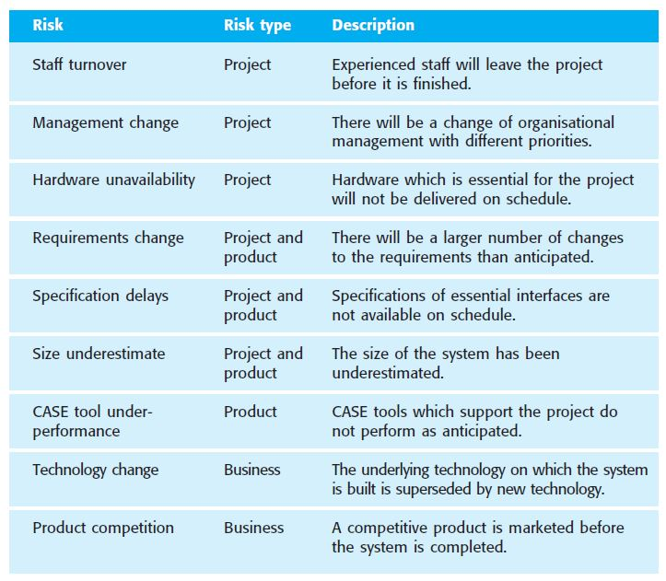

Slide 15
The Risk Management process Stages
Risk identification
Identify project, product and business risks;
Risk analysis
Assess the likelihood and consequences of these risks;
Risk planning
Draw up plans to avoid or minimise the effects of the risk;
Risk monitoring
The risk is constantly assessed and plans for risk mitigation
are revised as more information about the risk becomes available.

Slide 16
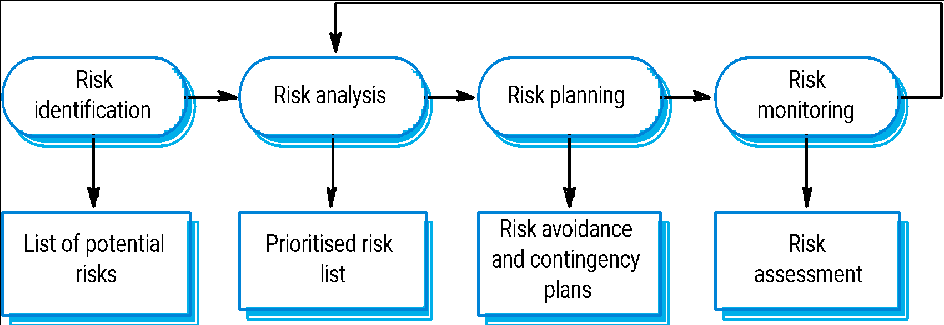
The Risk Management Process

Slide 17
Risk identification
Risk identification is the first stage of risk management which is concerned with discovering possible risks to the project.
Risk identification may be carried out as a team process using a brainstorming approach or may simply be based on experience.

Slide 18
Risk identification
Technology risks.
People risks.
Organisational risks.
Requirements risks.
Estimation risks.

Slide 19
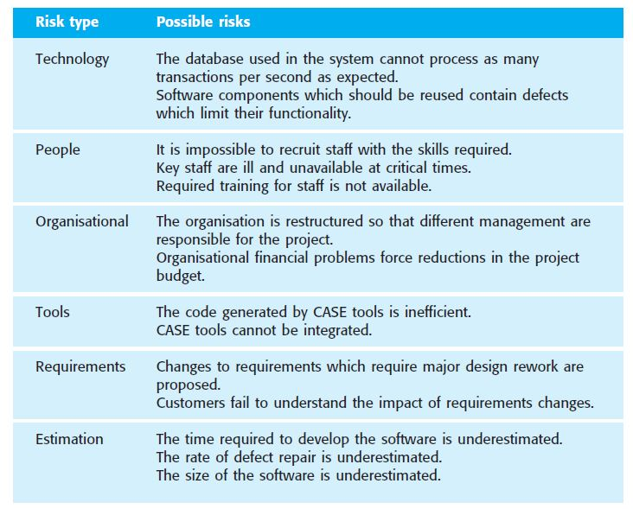
Risks and risk types

Slide 20
Risk analysis
Assess probability and seriousness of each risk.
Probability may be very low, low, moderate, high or very high.
Risk effects might be catastrophic, serious, tolerable or insignificant.

Slide 21
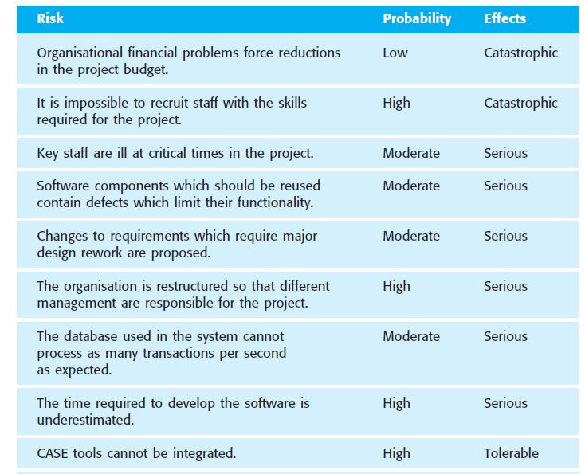
Risk analysis (i)

Slide 22
Risk planning
Consider each risk and develop a strategy to manage that risk.
These strategies fall into three categories:
Avoidance strategies
The probability that the risk will arise is reduced;
An example is the strategy for dealing with defective components
Minimisation strategies
The impact of the risk on the project or product will be reduced;
An example of a risk minimization strategy is that for staff illness.
Contingency plans
If the risk arises, contingency plans are plans to deal with that risk;
for example the strategy for organizational financial problems

Slide 23
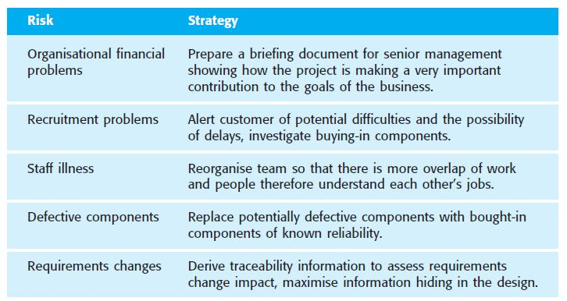
Risk management strategies (i)

Slide 24
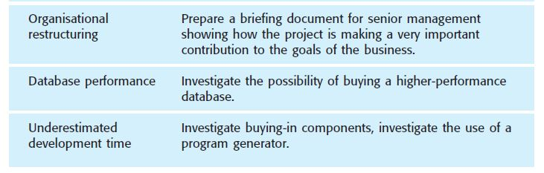
Risk management strategies (ii)

Slide 25
Risk monitoring
Assess each identified risks regularly to decide whether or not it is becoming less or more probable.
Some factors that give us clues about the risk probability and its effects must be observed. These factors are obviously dependent on the types of risk.

Slide 26
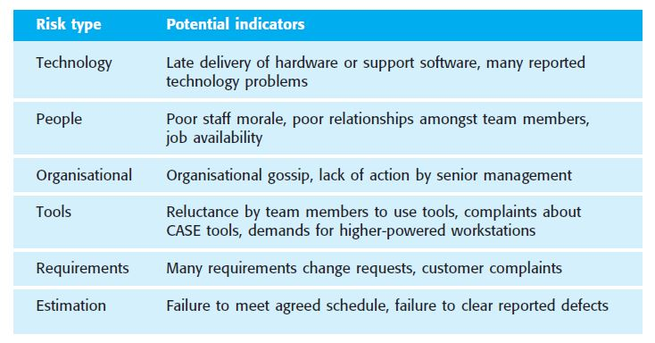
Risk indicators

